Slide 1
let your training journey begin

Slide 2
I’d like to learn about this product myself…

Slide 3
Using this presentation
Navigate to a specific section using the interactive links on the next slide, OR
Follow along slide-by slide
We recommend you view this PowerPoint in Presentation mode for the best experience.

Slide 4
Contents
Introduction to the platform
Why watch educational video? What is it? What’s in it? Who is it for?
Getting started on the platform
The homepage, browsing, searching
The Video page
Video page features and functionality
Creating a Profile
Saving searches, adding videos to lists, and creating video clips

Slide 5
Introduction to the platform
Back to Contents
Why watch educational video?
What is it? What’s in it? Who is it for?

Slide 6
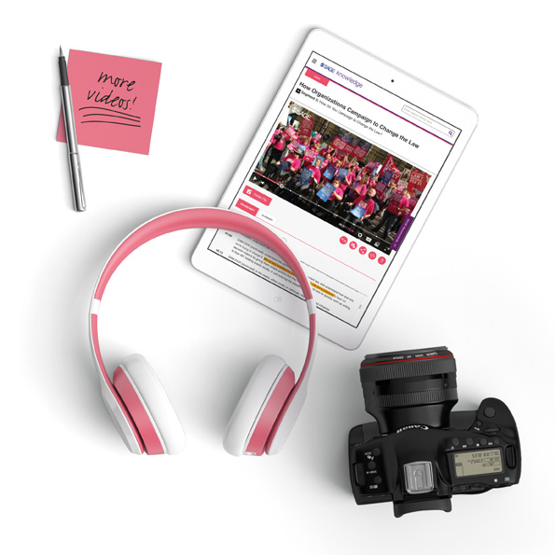
Why watch educational video?
We conducted market research in the 2014/15 academic year, White paper study conducted by SAGE
We surveyed 1673 students
49% undergraduate
33% graduate/post-graduate
18% unspecified
Respondents came from North America, Asia Pacific, Europe and South America

Slide 7
Why watch educational video?
According to our respondents, these are the reasons people watch educational video:
63.4% Professor plays it during class
59.3% For help in understanding course material
43.2% Assigned as homework prior to class
41.4% Assigned as supplemental material
34.3% To see the steps necessary to do something successfully
31.8% To see a practical example of a theoretical concept
29.4% To get another perspective
25.1% As part of a research assignment
17.7% To illustrate a point in a presentation you are making

Slide 8
SAGE Video is a series of streaming video collections developed in partnership with leading academics, societies and practitioners, to deliver pedagogical and research-oriented video mapped to disciplinary curricular needs.
You can access the platform at:
http://sk.sagepub.com/video

Slide 9
What’s in it?
SAGE Video is currently made up of nine subject collections:
Business & Management Politics & International Relations
Psychology Counseling & Psychotherapy
Education Media, Communication, & Cultural Studies
Sociology Criminology & Criminal Justice
Social Work
The content you can access through SAGE Video will depend on the subscription at your library
If you do not have access to particular content, you will see the following icon next to the resource:
If you aren’t sure which video subject collections your institution subscribes to, please check with your library staff

Slide 10
What’s in it?
Business & Management
# Videos: 558
# Hours 150+
Politics & International Relations
# Videos: 313
# Hours: 130+
Counseling & Psychotherapy
# Videos: 479
# Hours: 140+
Psychology
# Videos: 426
# Hours: 130+
Social Work
# Videos: 331
# Hours: 100+
Media, Communication, & Cultural Studies
# Videos: 575
# Hours: 140+
Criminology & Criminal Justice
# Videos: 548
# Hours: 120+
Sociology
# Videos: 330
# Hours: 120+
Education
# Videos: 548
# Hours: 140+

Slide 11
2015
Education, Counseling and Psychotherapy, and Media, Communication & Cultural Studies
2016
Business & Management, Politics & International Relations, and Psychology
2017
Sociology, and Criminology & Criminal Justice
2019
Social Work

Slide 12
SAGE Video collections
Created to support pedagogical needs across higher education, from undergraduate teaching and learning, student reference, research projects, through to higher level academic interest material
Developed with our author and editor networks to meet pedagogical needs; overseen by an Editorial Advisory Board
All videos available globally
About 60% of content exclusive to SAGE
New and original productions, plus licensed material

Slide 13
Video types
There are 13 video types, designed to help with different objectives in teaching or learning situations – each type has a different use.
The six most common are:
Video cases shed light on a key course topic, examining a certain context or problem
Documentaries to explore a particular theme or topic in-depth
In Practice to make connections between theory and practice with a real-life context
Interviews with leading academics
Tutorials explaining the principles of a key course topic; how to understand it; how to do it; key points
Definitions of key terms and concepts

Slide 14
Who is it for?
Faculty
Keep students engaged with exciting video content
Embed directly into Learning Management Systems for convenient access
Rely on high-quality, stable videos that won’t disappear
Choose from curriculum-mapped content, direct from the experts
Students
Study and self-serve at their own pace
Understand how concepts are really applied, beyond the book
See academics and practitioners in the flesh
Feel confident referencing reliable, credible content from an academic publisher
Researchers conducting independent projects
Refer to real-life examples for deeper understanding
Get inspired for new research topics
Engage critically with multiple perspectives
Librarians providing research subject, information workshops
Bring valuable video resources to the academic community
Meet changing expectations of the learning landscape
Ensure patrons are using quality, citable resources

Slide 15
Getting started on the platform
Back to Contents
The homepage, browsing, searching

Slide 16
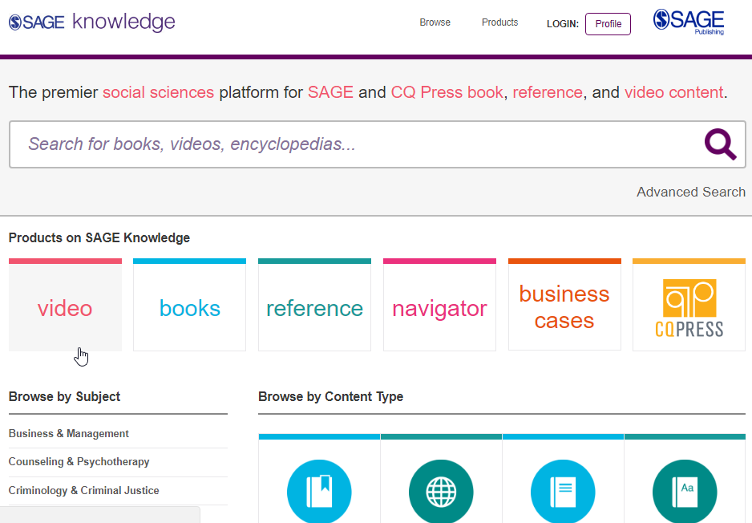
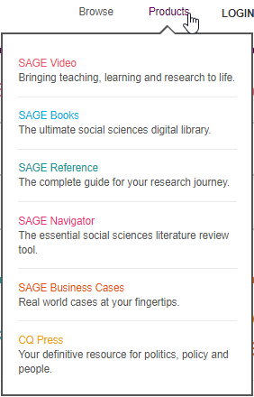
The SAGE Knowledge homepage
Hover over Products at the top of the page and click SAGE Video.
SAGE Video is hosted on the SAGE Knowledge platform.
To get to the SAGE Video homepage, click on Video under Products on SAGE Knowledge.
You can access SAGE Knowledge by going to http://sk.sagepub.com
You can access SAGE Video directly by going to http://sk.sagepub.com/video
Please note, it is possible that some of these content options will appear in grey on your screen, if your institution does not subscribe to a particular content group.

Slide 17
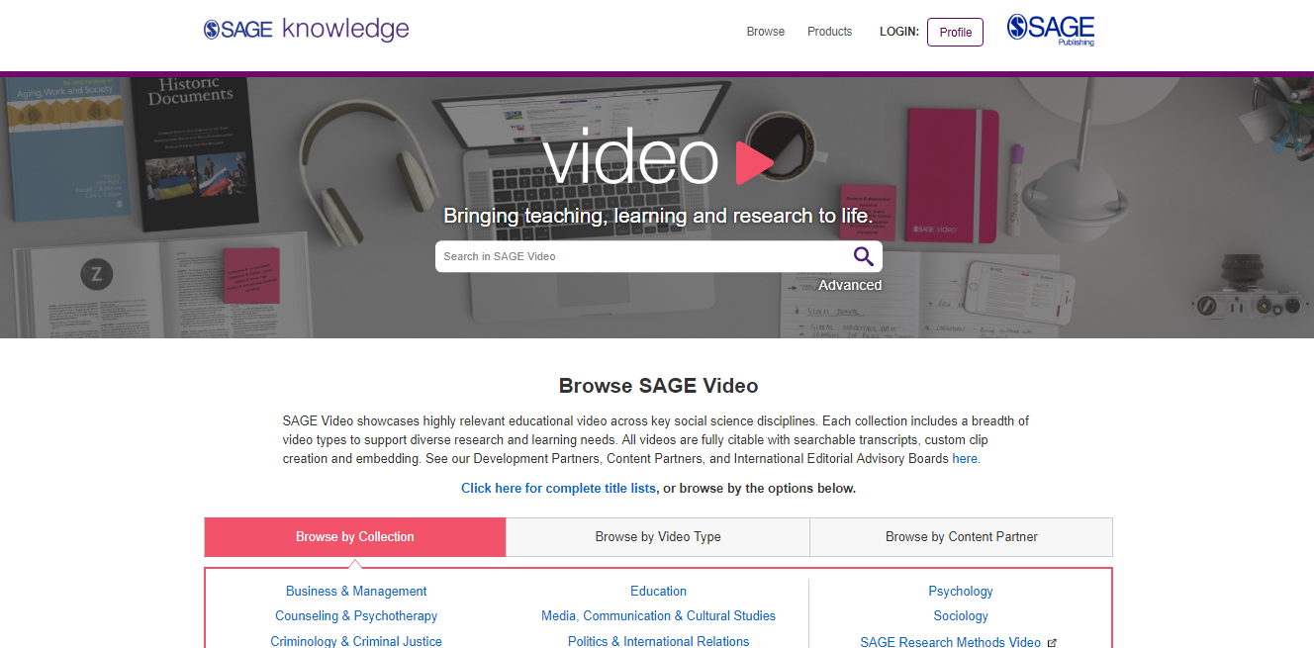
The SAGE Video homepage sk.sagepub.com/video
SAGE Video content will also be available through your library catalogue, and search engines like Google.
Please note, it is possible that some of these content options will appear in grey on your screen, if your institution does not subscribe to a particular content group.

Slide 18
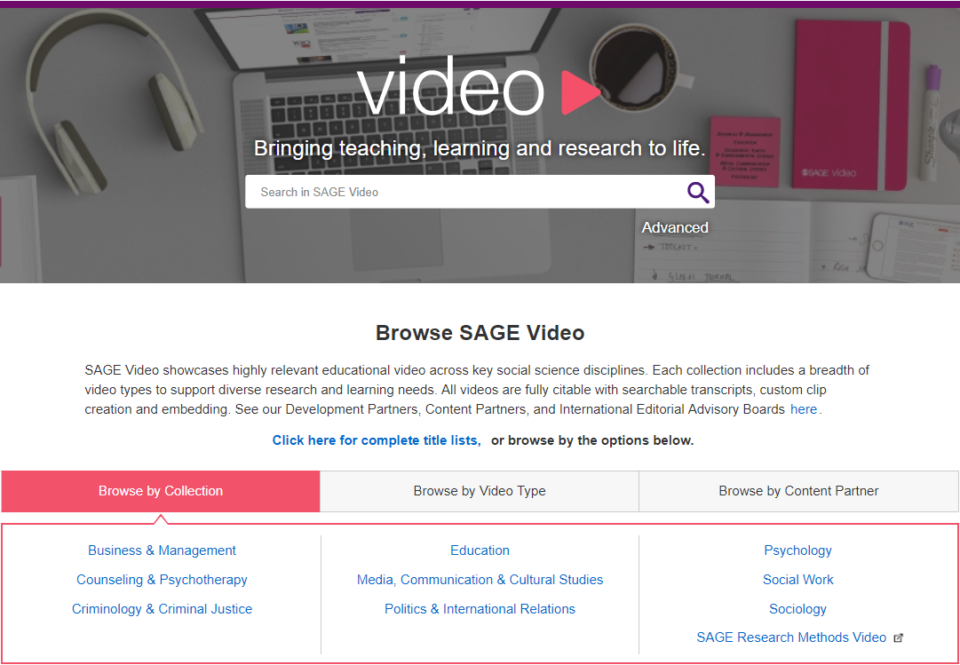
Browsing from the SAGE Video homepage
Browse by Collection to get to the video subject collection homepage, or by Video Type, or Content Partner to immediately discover videos.

Slide 19
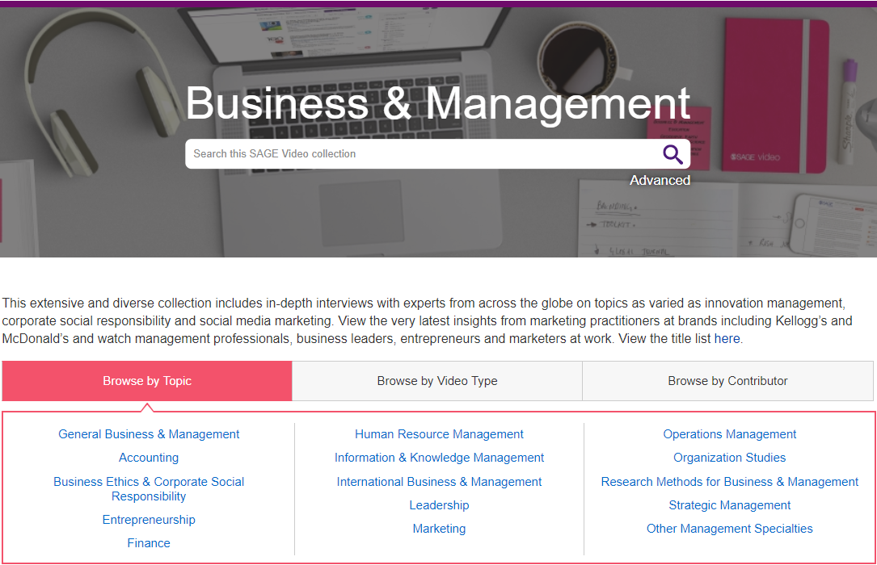
Browsing from the video subject collection homepage
Browse by Video Type or Contributor to immediately discover videos.
Browse by Topic to access the subject taxonomy to get a more granular breakdown of the Topic.

Slide 20
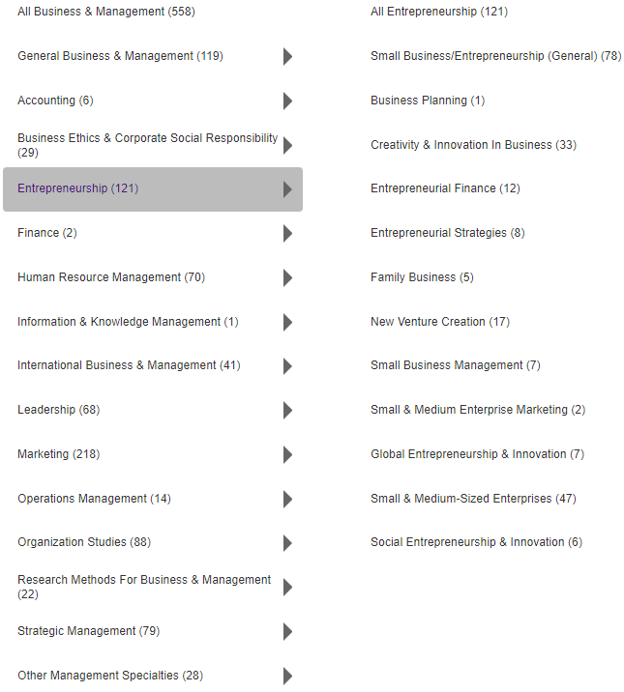
Subject taxonomies
Subject taxonomies allow you to discover videos on your specialised topic or research area.
They are a great way of seeing what is covered in the collection, especially if you’re not sure of your key word search terms.

Slide 21
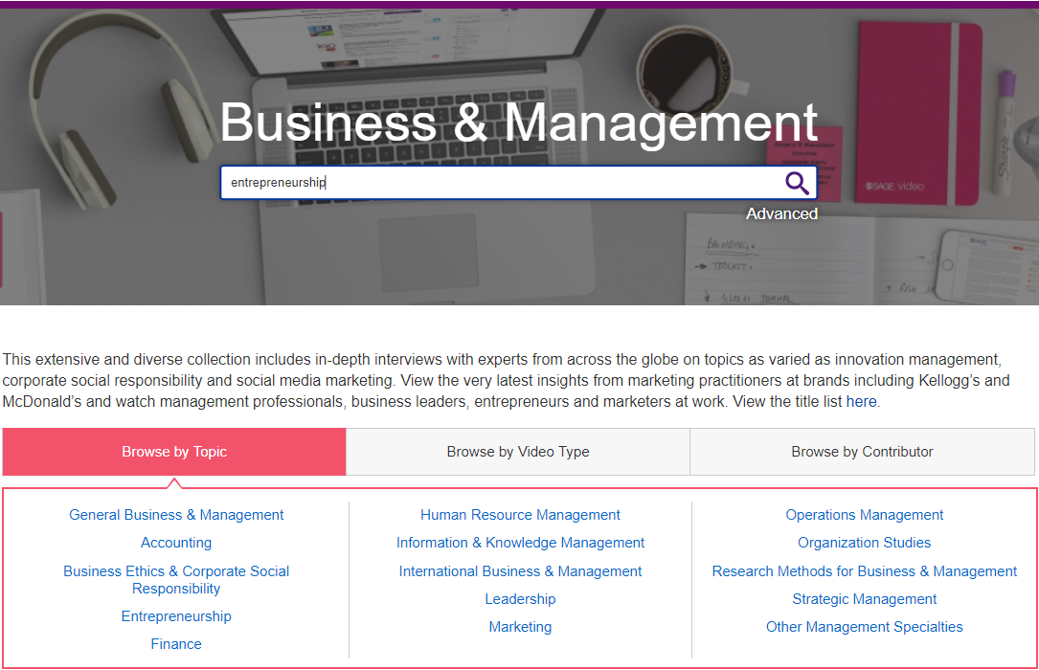
Using the Quick Search
Use the quick search to look for key words and phrases; you can use Boolean Operators AND, OR and NOT.

Slide 22
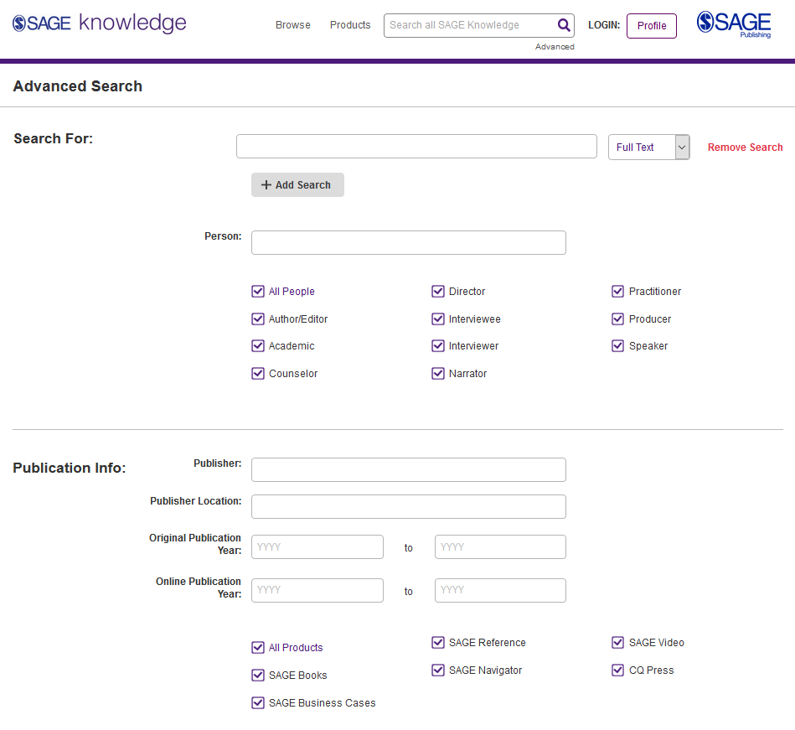
Using the Advanced search
Enter your search criteria, and add new rows to search multiple criteria
Access the Advanced search from any page on the platform
Search specifically for people, e.g. authors
Select which products you want to search across
Select your publication date ranges
Explore more search options further down the page

Slide 23
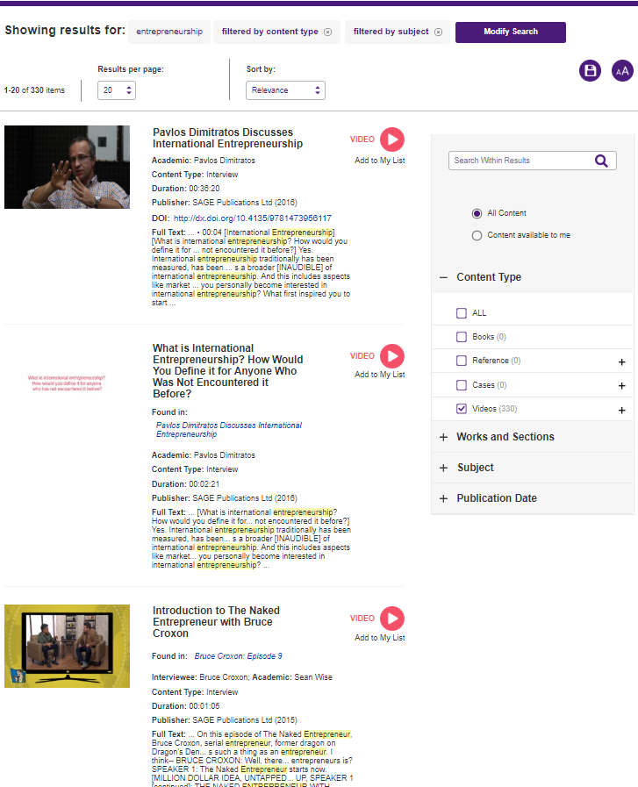
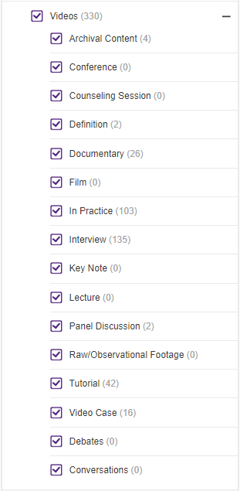
Viewing your results
The Availability filter ensures that you only see resources that are available through your library’s subscription.
Click the video title to view the full-length video.
Use the filters on the right-hand side of the search results page to refine your search by Video Type, Subject and Publication Date.
Resource is not available through your library’s subscription

Slide 24
Applying your learning
Visit the SAGE Video homepage at http://sk.sagepub.com/video or find it via your library catalogue
Find a video in your subject area using Browse by Topic
Run a search based on a current assignment or project you are working on
Use the filters to look at videos from one video type

Slide 25
The Video page
Back to Contents
Video page features and functionality

Slide 26
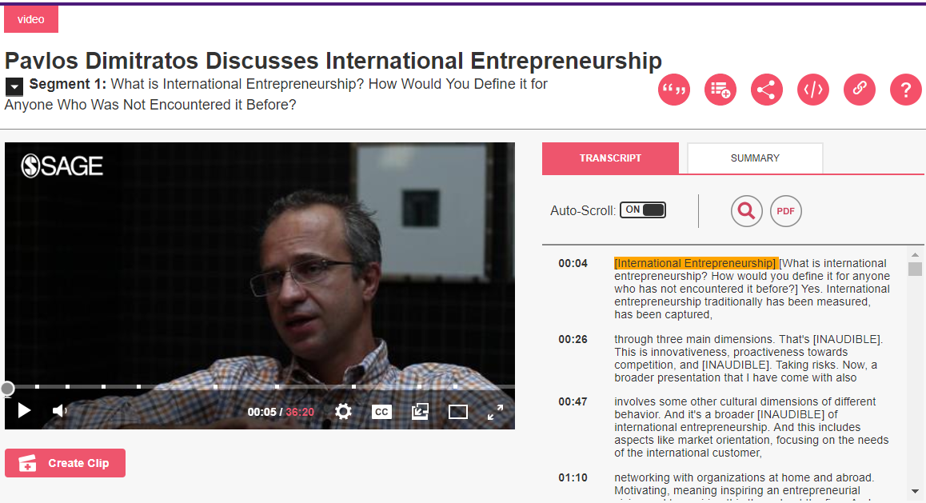
SAGE Video page
Use the functions at the bottom of the video display to adjust the volume, increase and decrease the video quality and playback speed, add subtitles, open in a new tab, or view full-screen.

Slide 27
SAGE Video page
Videos are streaming only, but you can download a PDF of the video transcript by clicking the PDF icon.
Use the auto-scrolling transcript to follow along with the video as it plays.

Slide 28
SAGE Video page
Use the icons to the right of the video title to: generate Citations in 4 referencing styles, Add to My List to add a video to a list, Share with a friend, student or colleague, Embed a video into a learning management system (LMS) or virtual learning environment (VLE), or Link to generate a permalink to link to the video page directly.
*You will need to be signed in to your Profile to add videos to a list.*
TIP: To learn how to create your Profile, click here.

Slide 29
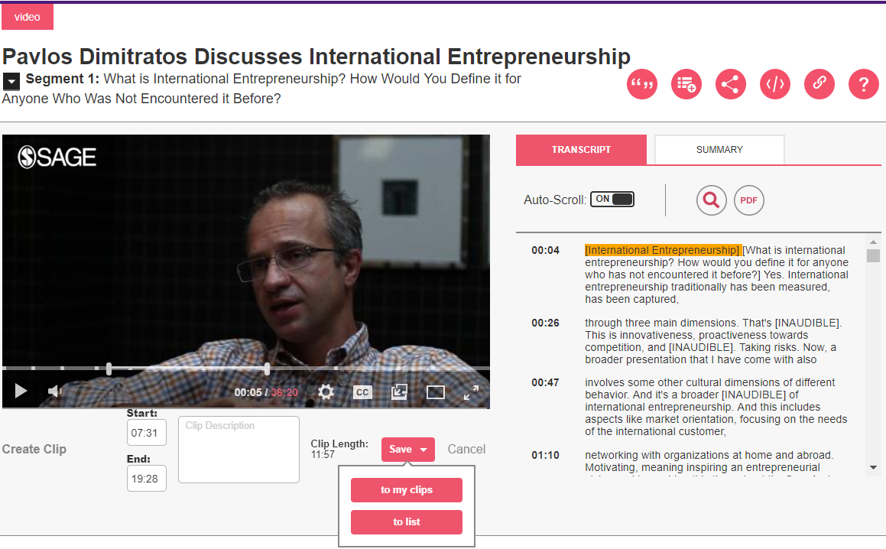
Create video clips
Create video clips
Click on Create Clip.
Use the sliders that appear on the video to select the start and end times of your clip.
Click on Save to add to the clip To My Clips (a list just for clips) or To List.
Choose the list you’d like to add the video clip to, or create a brand-new list.
*You will need to be signed in to your Profile to save clips.*
TIP: To learn how to create your Profile, click here.
TIP: To learn how to access your lists, click here.

Slide 30
Applying your learning
Open a video and download the PDF transcript
Download the citation for your chosen video
Create a video clip, and save it to My Clips

Slide 31
Creating a Profile
Back to Contents
Saving searches, adding videos to lists, and creating video clips

Slide 32
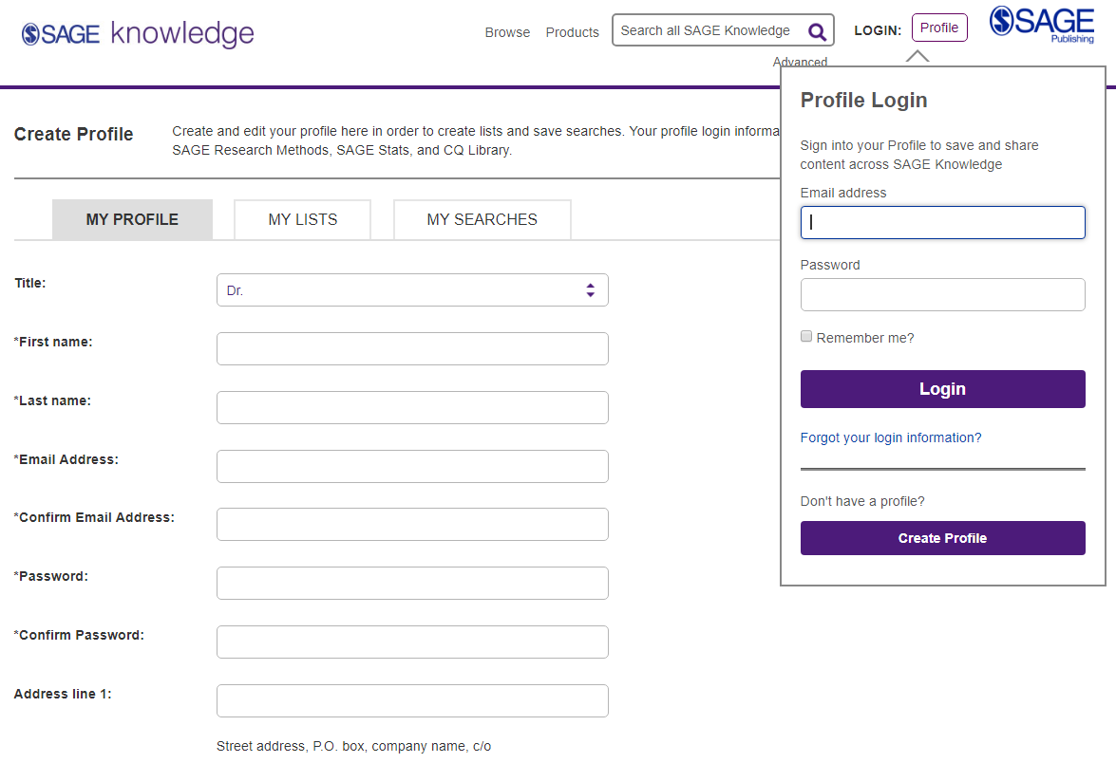
Creating a profile
Click the Profile button and then click on the button Create Profile.
Click the Profile button and then click on the button Create Profile.
Once you’ve clicked the Create Profile button, fill in your details in the registration form to set up your free Profile, so that you can save searches, and add resources to reading lists.

Slide 33
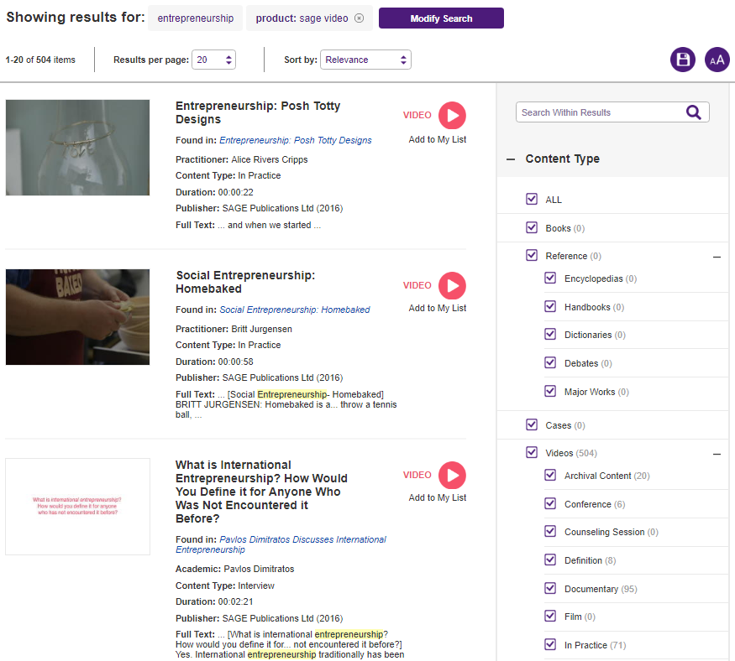
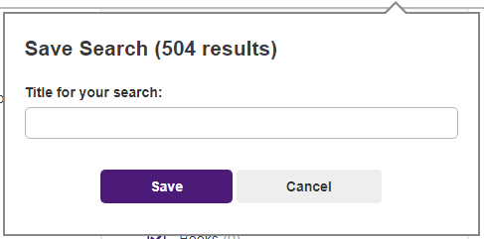
Saving searches
When you’re logged into your Profile and you are viewing your search results, click the purple Save icon to save your search criteria, so that you can quickly re-run the same search again later.
Once you’ve clicked the purple Save icon, give your search a title, and then click the purple Save button.

Slide 34
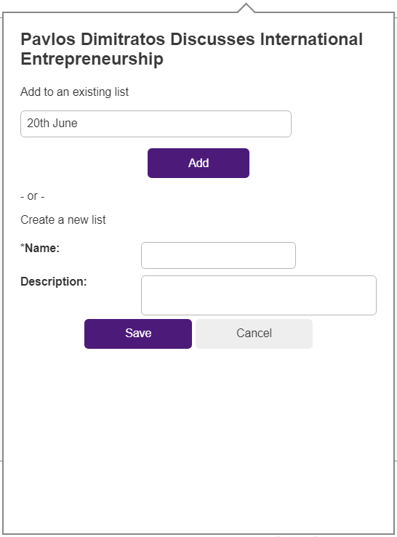
Managing lists
When logged in to your Profile, you can add videos to My Lists in order to save items of interest for later.
On any video page, click the Add to My List icon.
When the pop-up window appears, choose an existing list to add your video to, or create a new list.

Slide 35
Create video clips
Create video clips
Click on Create Clip.
Use the sliders that appear on the video to select the start and end times of your clip.
Click on Save to add to the clip To My Clips (a list just for clips) or To List.
Choose the list you’d like to add the video clip to, or create a brand-new list.
*You will need to be signed in to your Profile to save clips.*
TIP: To learn how to access your lists, click here.

Slide 36
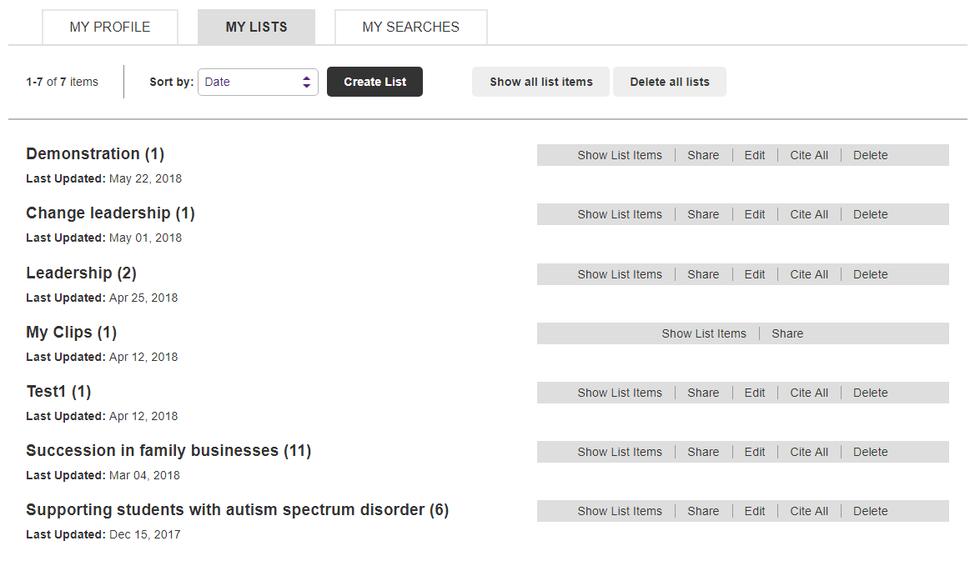
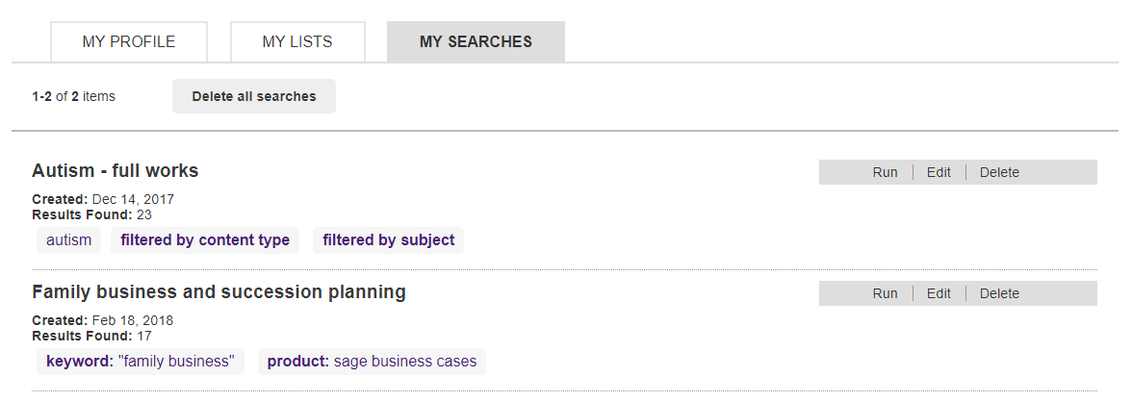
Managing your Profile
You can access your lists and saved searches by clicking on My Profile from any page when you are logged in.
My Lists
My Searches

Slide 37
Applying your learning
Create a free profile on SAGE Video from any page of the platform
Save a search based upon a current assignment or project
Save one video to My Lists
Create a video clip, and save it to My Clips

Slide 38
Want to learn more?
If you are in Europe, the Middle East, Africa, Asia, or Oceania, you can explore more of our training resources here.
If you are in North America, Latin America, or the Caribbean, you can explore more of our training resources here.

Slide 39
Thank you for watching!
Back to Contents

