Slide 1
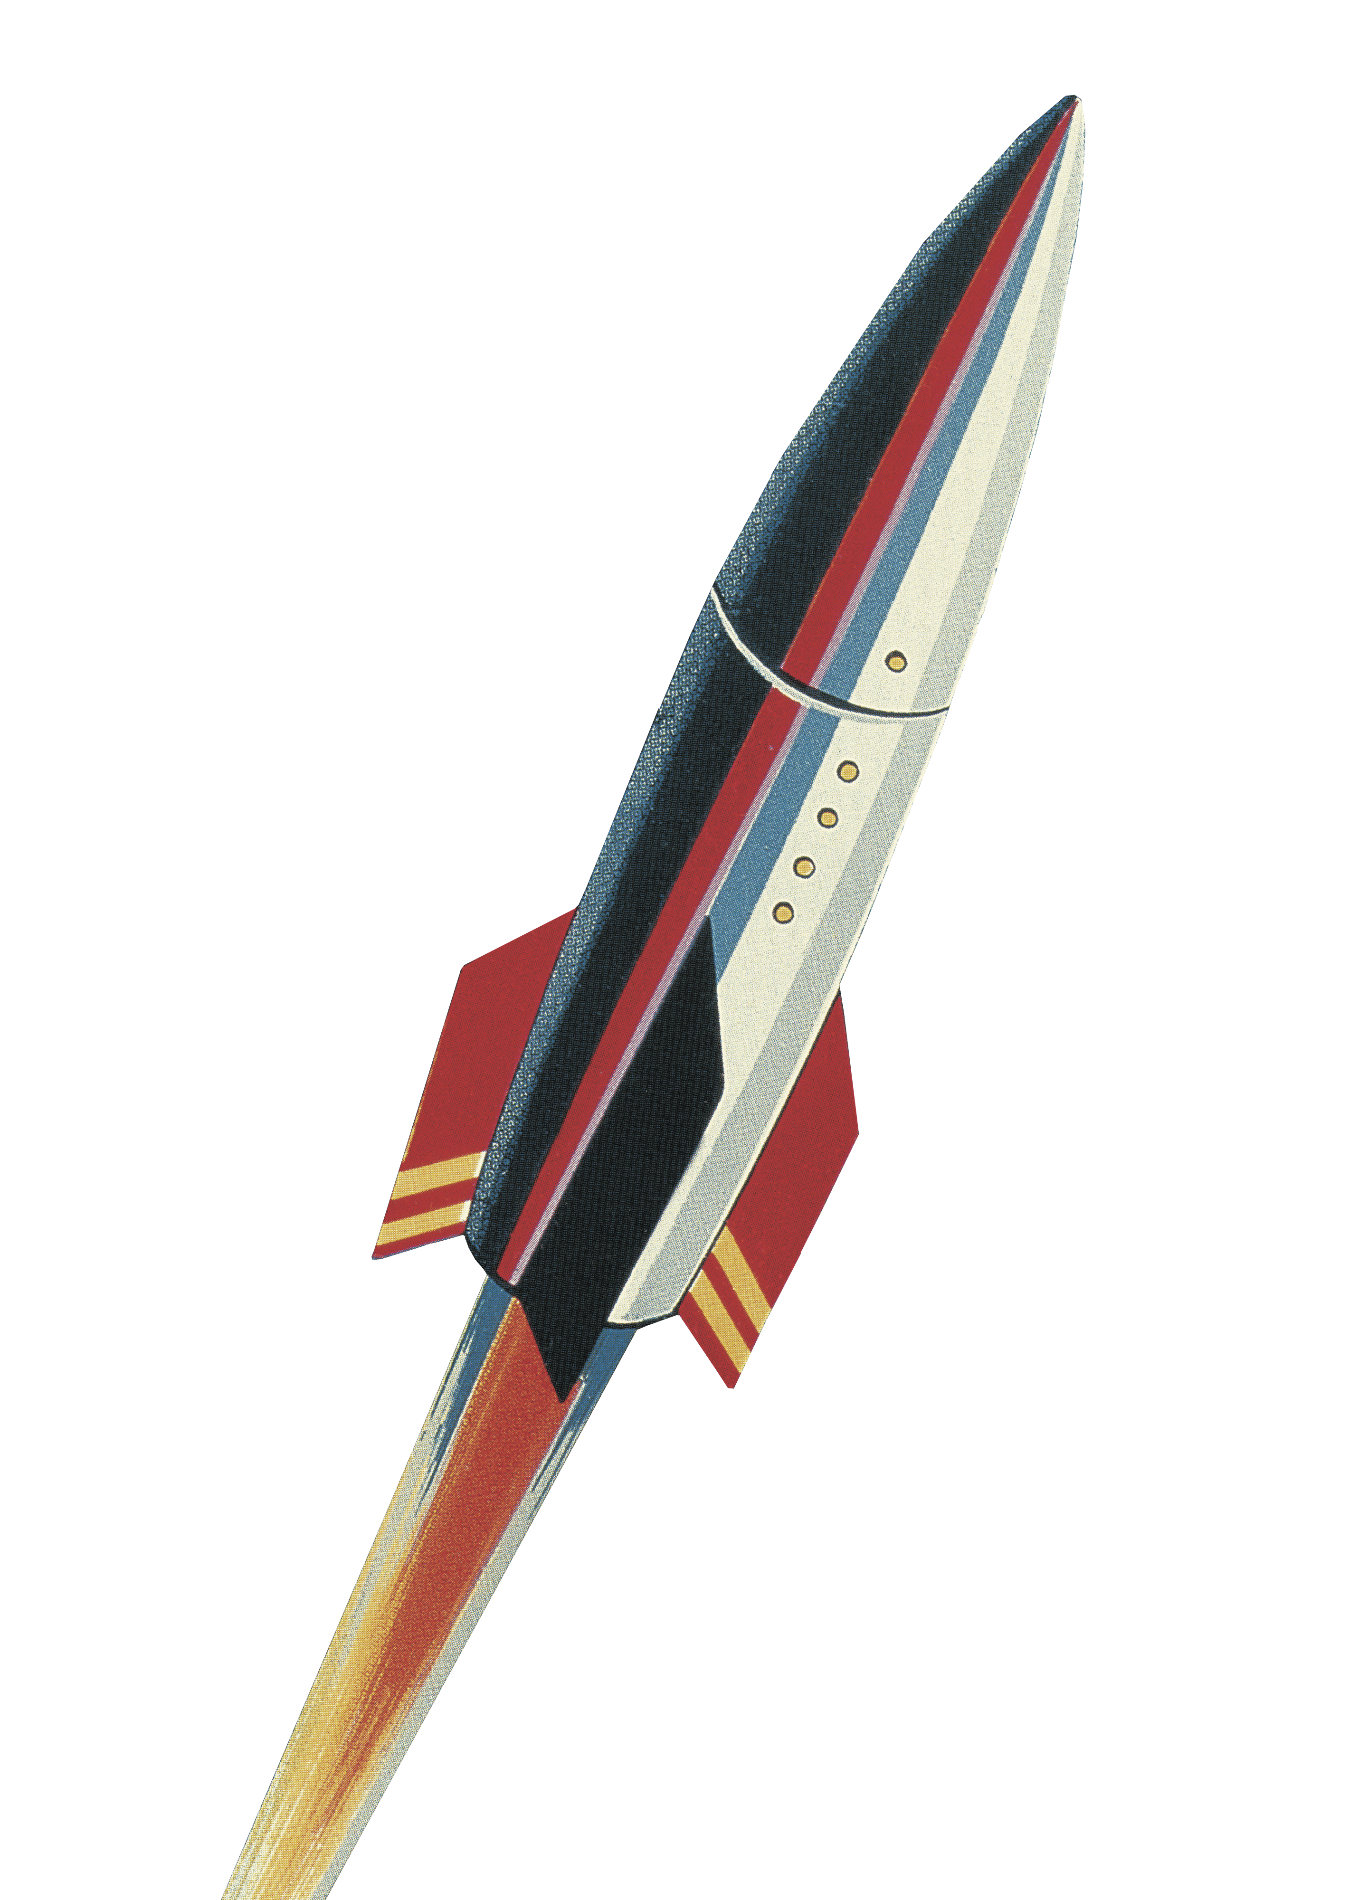
let your training
journey begin

Slide 2
SAGE Journals
Workshop for {…}
{Your name}

Slide 3
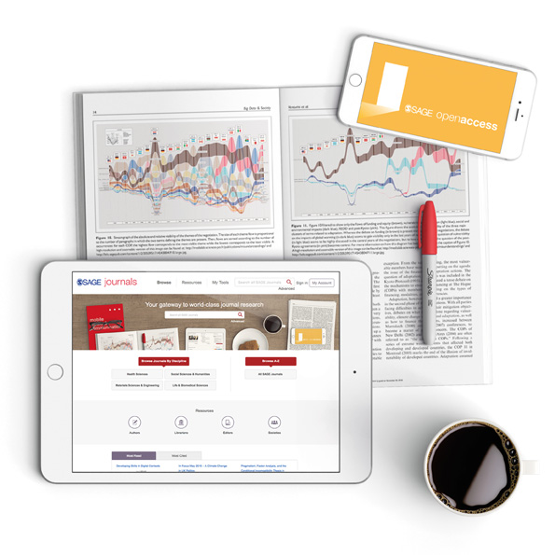
Session outline
Introduction to SAGE Journals
Live platform demonstration
Final questions and session round-up

Slide 4
Session objectives
By the end of this session, participants will be able to:
Describe how SAGE Journals can help them with their research
Locate relevant articles appropriately using browse and search tools
Set up email alerts for new articles through their free account

Slide 5
Discussion questions
What research projects are you currently working on or interested in?
How familiar are you with the journals that SAGE publishes in your subject area or field of interest?
What do you hope to gain from today’s session?

Slide 6
Introduction to the product
What is it? What’s in it? Who is it for?

Slide 7
SAGE Journals is a platform that hosts all of SAGE’s journals, giving you access to timely, high-quality, peer-reviewed research articles in your discipline.
SAGE publishes in many disciplines, from Communication, Education and Psychology through to Engineering, Medicine and Research Methods. You can browse all our journal titles at
http://journals.sagepub.com/action/showPublications

Slide 8

What’s in it?
The content you can access through SAGE Journals will depend on the subscription at your library
It’s possible your library does not subscribe to all of our journals
If you do not have access to a particular article, you will see the following icon next to the article:
If you aren’t sure which journals your institution subscribes to, please check with your library staff

Slide 9
Who is it for?
Students and researchers
    Learn the key themes and debates on your topic
    Keep track of the most recent developments in your subject area
    Conduct literature reviews for your research projects
    Find authoritative references for your assignments and research
    Understand what makes a good-quality journal article
Faculty
    Help students understand their study topics with evidence-based research
    Link to articles and relevant journals in your Learning Management System
    Stay up-to-date on the most recent developments in your field
    Get an alternative view of impact with Altmetric data

Slide 10
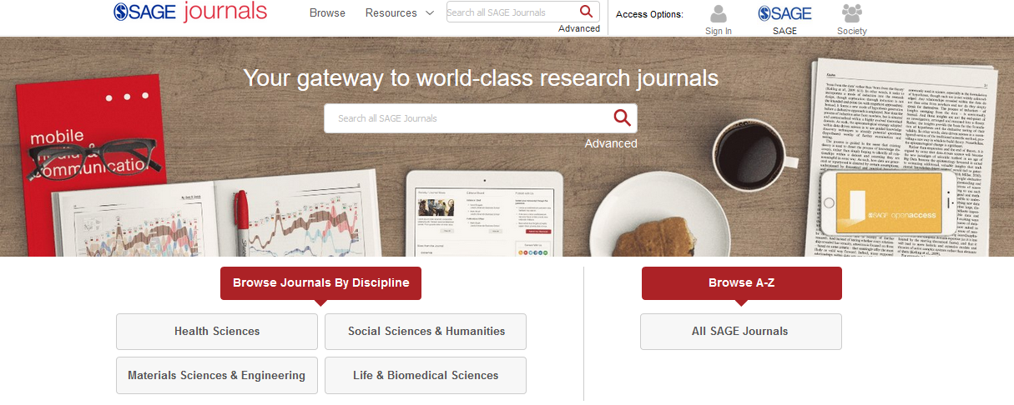
The SAGE Journals homepage https://journals.sagepub.com
SAGE articles will also be available through your library catalogue, and search engines like Google.

Slide 11
Using Browse options
You can browse our journals by discipline…
…or see all our journals in an alphabetical list.

Slide 12
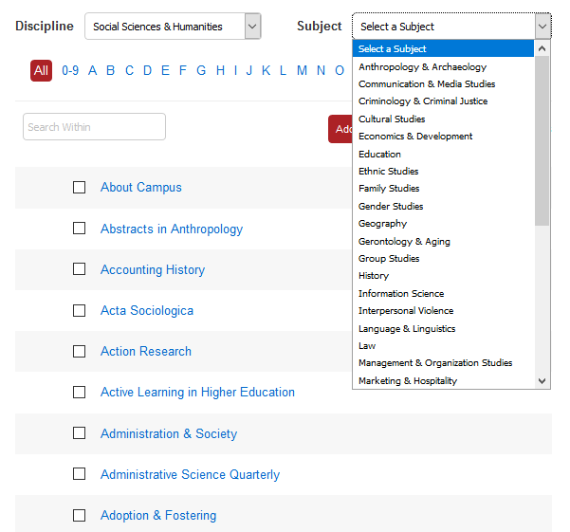
Using Browse options
Use the Browse drop-down menus to see what journals we publish in your subject area.
Click on a journal title to go to its homepage and start exploring the publication.

Slide 13
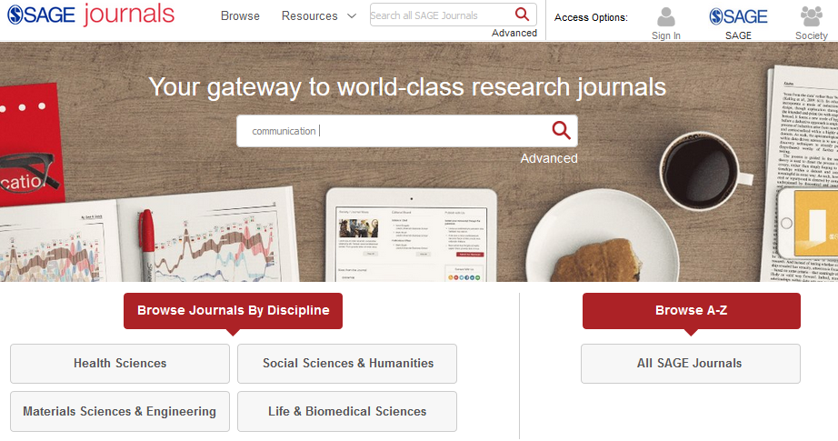
Using the Quick search
Use the quick search to look for key words and phrases; you can use Boolean Operators AND, OR and NOT.
You’ll also see the Quick search bar at the top-right of all pages on the platform.

Slide 14
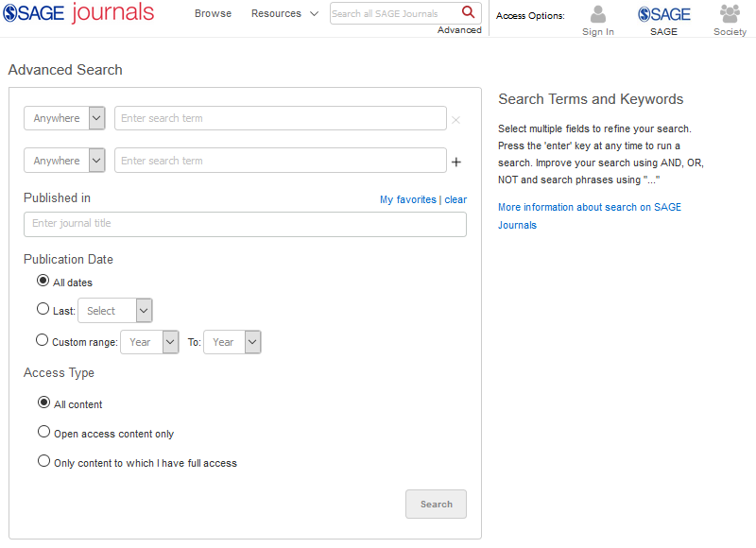
Using the Advanced search
Enter your search criteria
Access the Advanced search from any page on the platform
Add new rows of search criteria
Customise your publication date
Choose which content you want to see in your results
Choose to search within particular journals only, and to search only across journals saved to My Favorite Journals

Slide 15
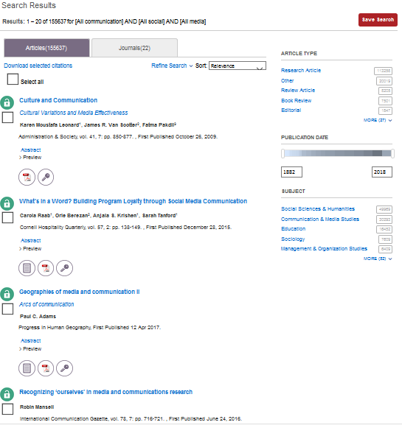


Viewing your results
Use the filters on the right-hand side of the search results page to refine your search.
Click the article title to view the article, or download the PDF straight away by clicking on the PDF icon.
The Publication Date slider ensures you are seeing the most recently-published results.
Article is available through your library’s subscription
Article is not available through your library’s subscription
Article is available because it is Open Access

Slide 16
Exploring journal content
Back to Contents
Journal portals and article pages

Slide 17
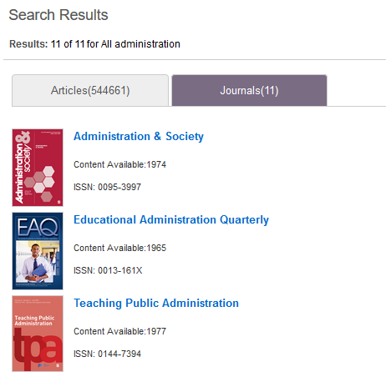
The journal portal
2) Run a search, select the Journals tab in the results page, then click on the journal title.
There are two ways of getting to a journal’s portal homepage:
1) Use the Browse page and click on the journal title.

Slide 18
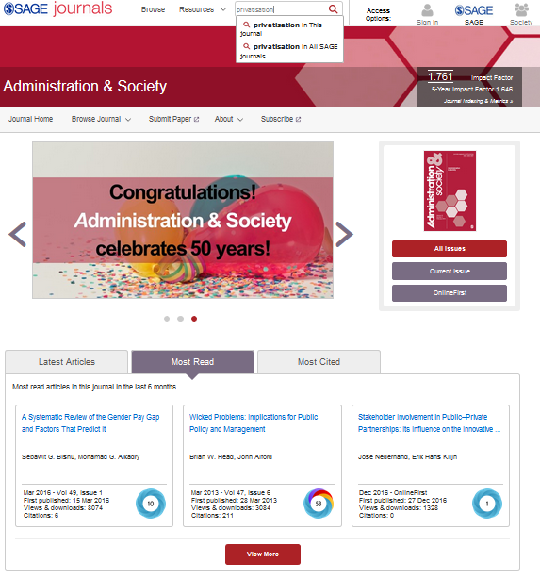
Submit your own research to this journal
Search only within this journal
View Impact Factor and journal ranking information for the journal
Browse current and all issues of this journal
Check OnlineFirst for early digital access to the most recent articles in this journal
View Latest Articles, Most Read and Most Cited articles from this journal
View Altmetric information for this journal article

Slide 19
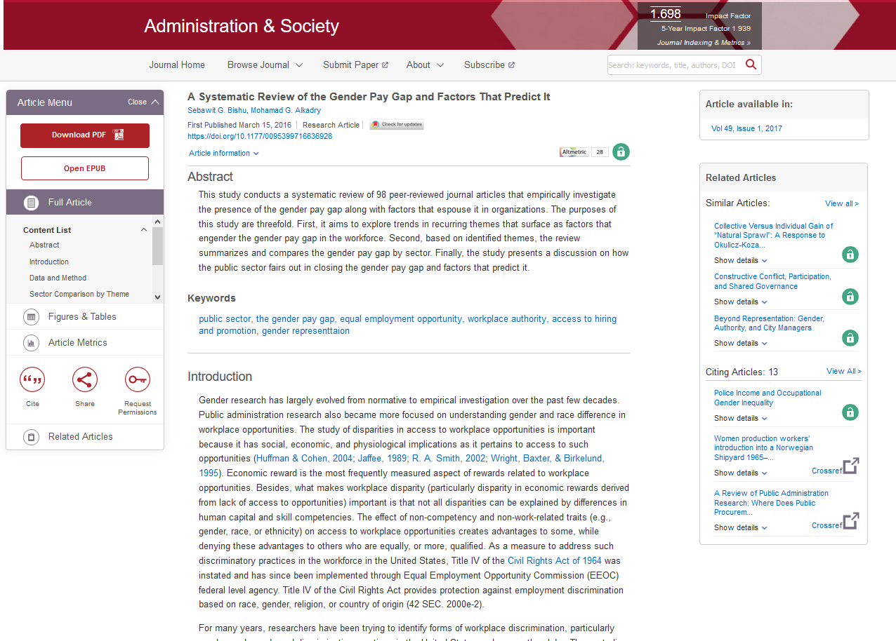
The article page
View author information
Download article PDF to read offline
View Almetric data for this article
Download EPUB for enhanced e-reader access
Run related keyword searches
Easily move between article full text, supplemental material, figures and tables and article metrics
View other articles that have cited the one you are viewing
View full-text of article
Download article citation information
Please note: some (older) articles are only available as PDFs and you will not see this webpage-view.
Share article link or access with a colleague or co-researcher

Slide 20
Creating an Account
Back to Contents
Saving searches, saving favourite journals and managing alerts

Slide 21
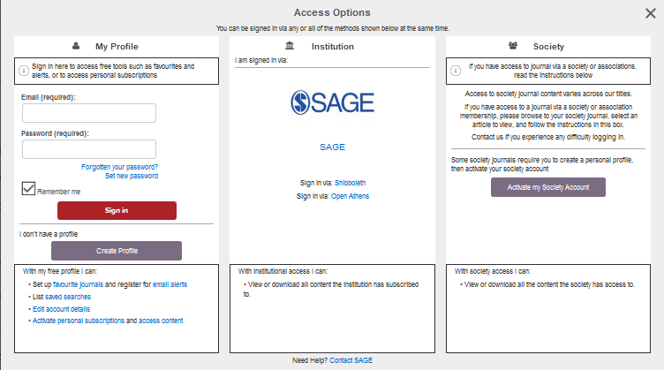
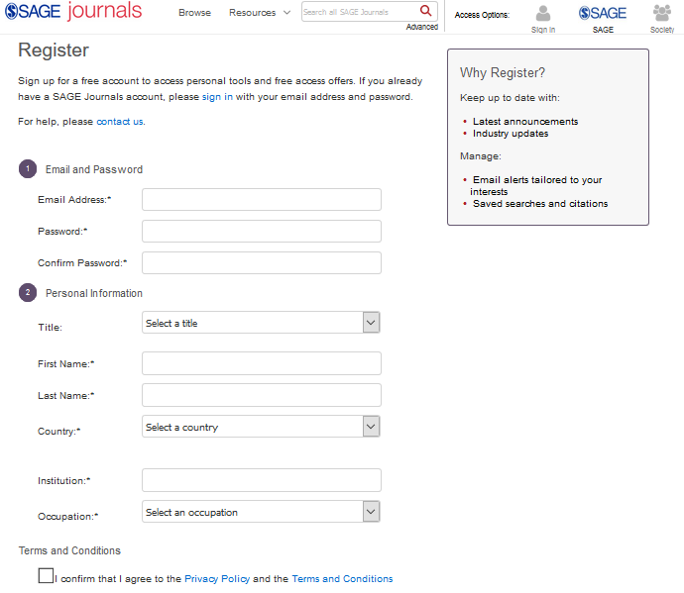
Creating an Account
Once you’ve clicked the button, fill in your details in the registration form to set up your free Account, so that you can save searches, set up alerts and add journals to your favourites.
Click the Sign in button at the top-right of any screen, and then click on Create Profile in the pop-up window.

Slide 22
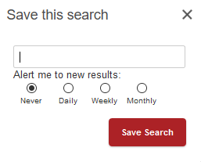
Saving searches
When you’re logged into your Account and you are viewing your search results, click the red Save Search button to save your search criteria, so that you can quickly re-run the same search again later.
You can also set up regular email alerts to be notified automatically when we publish new articles that match your search criteria.

Slide 23
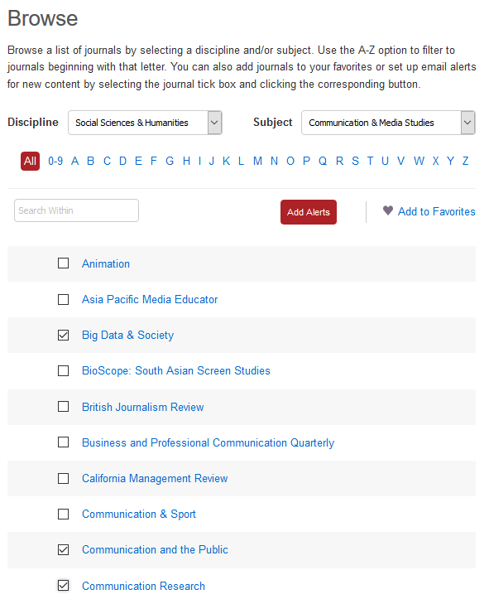
Saving favourite journals
When browsing our journals, select the tick-box of a journal you’re interested in, and click the Add to Favorites button.
Saving a journal to your favourites can be useful when you want to use the Advanced search, because you can choose from the journals you have saved.
You can favourite multiple journals at a time by selecting as many tick-boxes as you like.

Slide 24
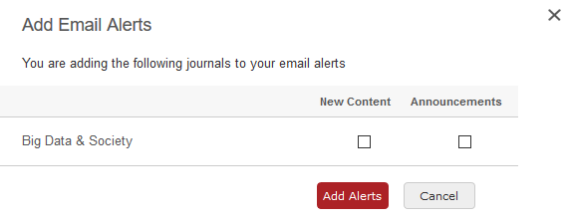
Setting up alerts
The first type of alert in SAGE Journals is the journal alert: this alerts you by email when new content is published in a specific journal.
From the Browse page, select the tick-box of the journal you want to receive email alerts for, then click the Add alerts button.
Confirm the alerts you want to receive, then click Add alerts. You can change the frequency of your alerts, and delete them, via My Account.

Slide 25
Setting up alerts
The second type of alert in SAGE Journals is the saved search alert: this alerts you by email when new content is published matching your saved search criteria.
Run your search and add your search filters. When you click the red Save Search button, you will be given the option to choose how frequently you want to receive an alert.

Slide 26
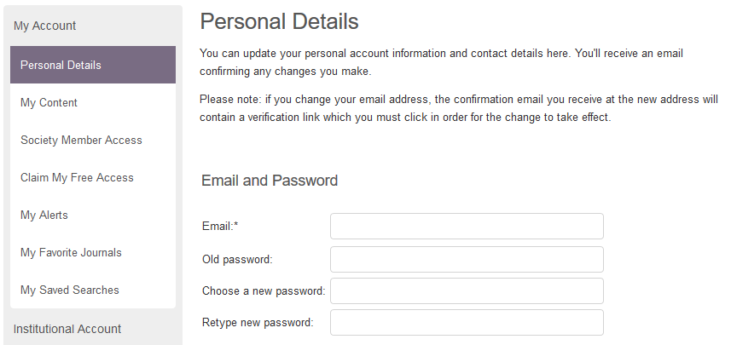
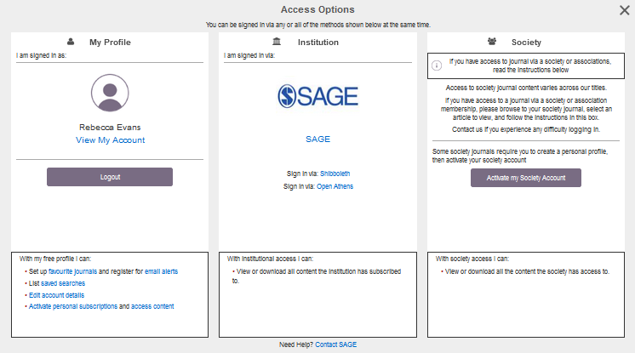
Managing your Account
From any page, click the Sign in button under Access Options. Once you are signed in, click View My Account in the pop-up window.
From any page, click the Sign in button under Access Options.
Use the menu options on the left to manage your alerts, your favourite journals and your saved searches.

Slide 27
Do you have any questions?

Slide 28
Thank you for listening!

