Slide 1
let your training journey begin

Slide 2
SAGE Knowledge
Workshop for {…}
{Your name}

Slide 3
Session outline
Introduction to SAGE Knowledge
Live platform demonstration
Final questions and session round-up

Slide 4
Session objectives
By the end of this session, participants will be able to:
Describe how SAGE Knowledge resources can help them in their study and research
Locate relevant resources using browse and search
Save a resource to a list within the platform

Slide 5
Discussion questions
How familiar are you with SAGE Knowledge?
What projects are you currently working on or interested in?
What do you hope to gain from today’s session?

Slide 6
Introduction to the product
Back to Contents
What is it? What’s in it? Who is it for?

Slide 7
SAGE Knowledge is where we host all our online book and reference content, ideal for learning new theories, concepts, debates and applications in your subject area.
SAGE Knowledge content covers the following subject areas:
http://sk.sagepub.com
Business & Management
Counseling & Psychotherapy
Criminology & Criminal Justice
Education
Geography, Earth & Environmental Science
Health & Social Care
Media, Communication & Cultural Studies
Politics & International Relations
Psychology
Sociology

Slide 8
What’s in it?
Full access to SAGE Knowledge includes over 4,000 books and over 600 reference items
However, the content you can access through SAGE Knowledge will depend on the subscription at your library; it’s possible your library does not subscribe to all the content
If you do not have access to a particular item, you will see the following icon next to it in the search results:
If you aren’t sure which content you have access to at your institution, please check with your library staff

Slide 9
Who is it for?
Students and researchers
Learn more about key topics in your subject area, at all levels of study
Get multiple perspectives on topics from SAGE authors all around the world
Save items to lists to keep track of useful information for your projects
Download citation information for easy referencing
Discover new resources with ‘Similar content’ recommendations
Faculty
Introduce students to high-quality content from well-known experts
Create engaging reading lists for your classes
Ensure students get easy access to full-text titles on- and off-campus
Allow all students to access whenever, wherever, with unlimited simultaneous users and a mobile-responsive design

Slide 10
Getting started on the platform
Back to Contents
The homepage, browsing, searching

Slide 11
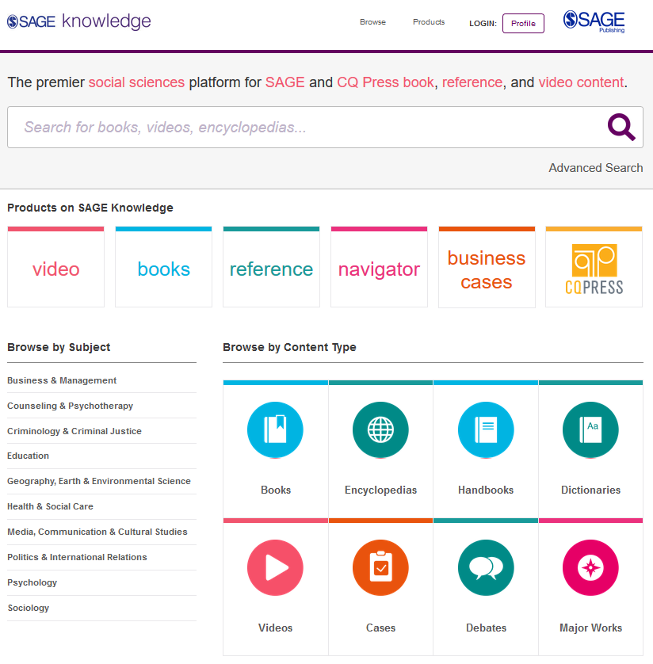
The SAGE Knowledge homepage
You can access SAGE Knowledge by going to https://sk.sagepub.com
SAGE books and reference items will also be available through your library catalogue, and search engines like Google.

Slide 12
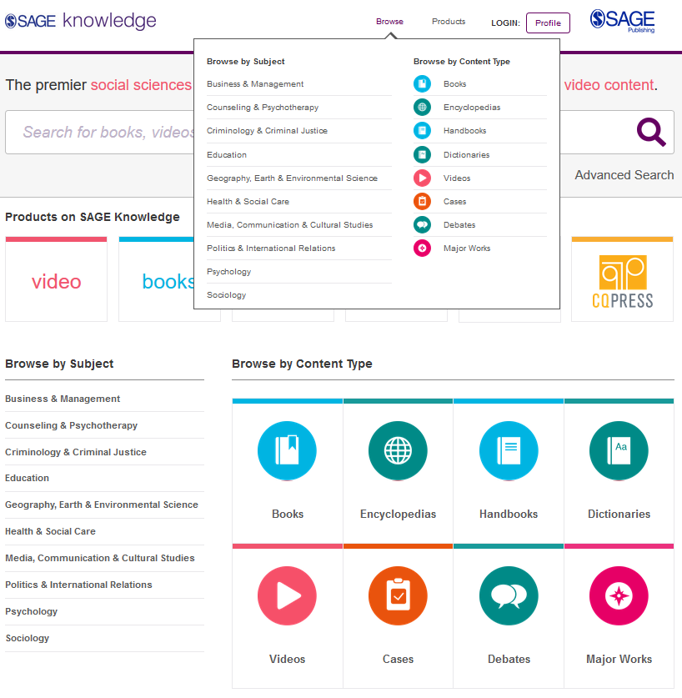
Browsing by Subject
Hover over the Browse menu at the top of the screen on any page to see all content for your subject area.
You can also Browse by Subject here on the homepage.
Please note, it is possible that some of these content options will appear in grey on your screen, if your institution does not subscribe to a particular content group.

Slide 13
Browsing by Content Type
Hover over the Browse menu and select one of the Browse by Content Type options if you want to see, for example, all of our Encyclopedias.
You can also Browse by Content Type here on the homepage.
Please note, it is possible that some of these content options will appear in grey on your screen, if your institution does not subscribe to a particular content group.

Slide 14
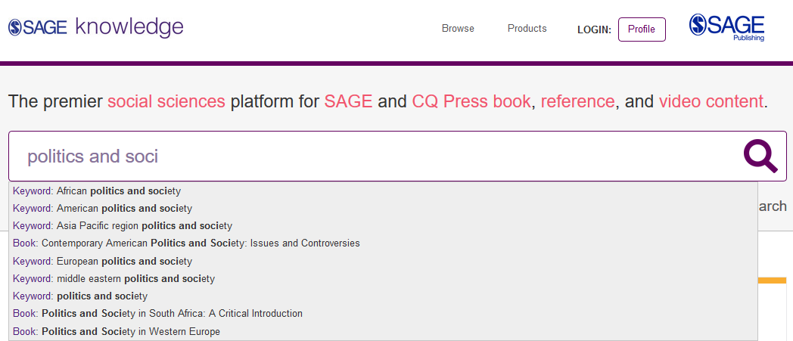
Using the Quick search
Use the quick search to look for key words and phrases.
Run the search for your own terms, or click on one of the auto-suggestions to go directly to that resource.

Slide 15
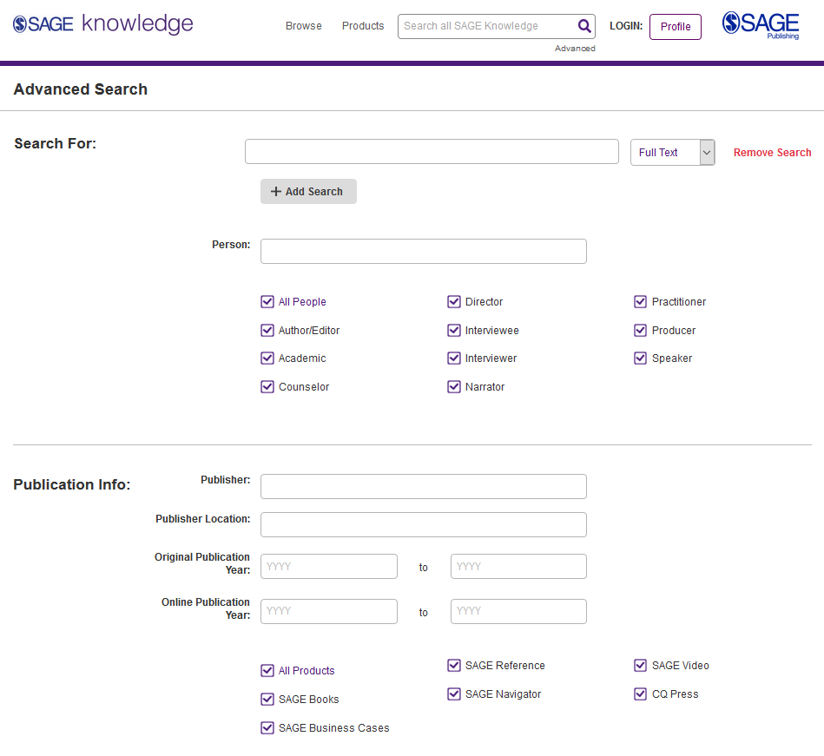
Using the Advanced search
Enter your search criteria, and add new rows to search multiple criteria
Access the Advanced search from any page on the platform
Search specifically for people, e.g. authors
Select which products you want to search across
Select your publication date ranges
Explore more search options further down the page

Slide 16
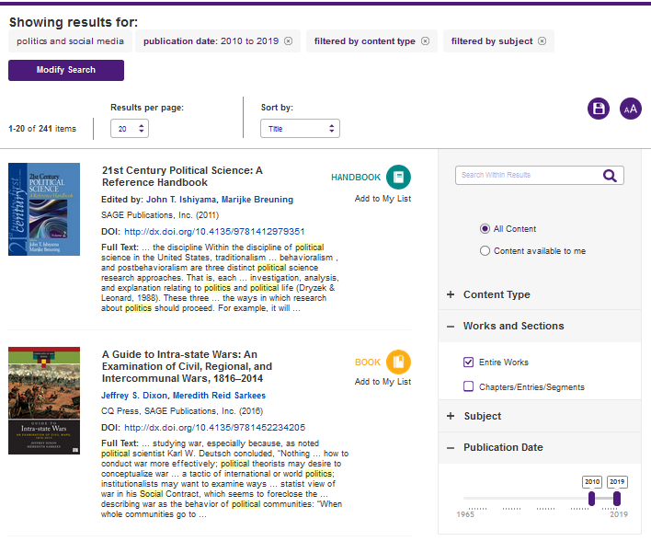
Viewing your results
Click the image or title to open the item.
Use the filters on the right-hand side of the search results page to refine your search; you can search within your results, filter by content type and subject, and use the publication date slider to find older or newer content.
Item is not available at your institution

Slide 17
The resource page
Back to Contents
Entire works and chapters and entries

Slide 18
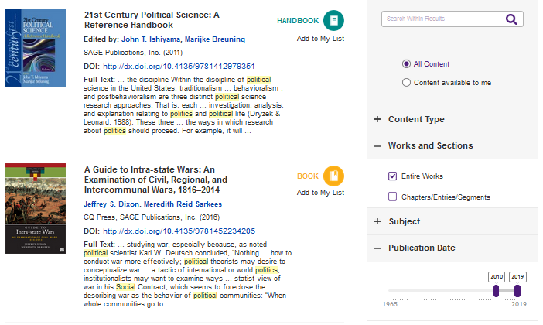
Entire Works
Entire Work refers to the complete version of a text, e.g. a whole Book or a complete Encyclopedia
When you are viewing your search results, if you leave only Entire Works selected, each complete work will only appear in the search results once.

Slide 19
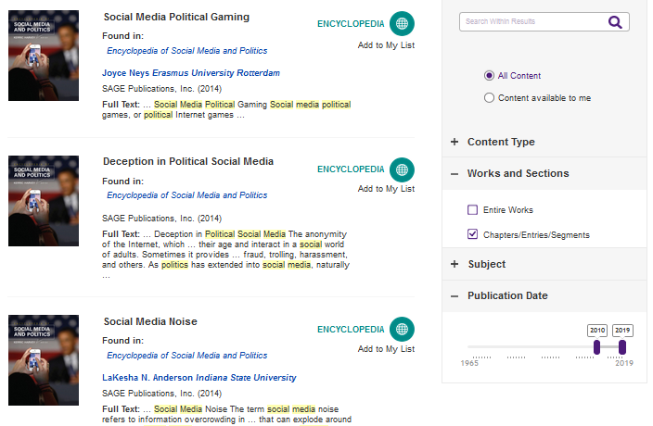
Chapters and Entries
Chapters and Entries refers to the individual component of a text, e.g. a chapter within a Book or an entry in an Encyclopedia
When you are viewing your search results, if you leave only Chapters/Entries selected, you will often see multiple entries or chapters from the same larger work in your results.

Slide 20
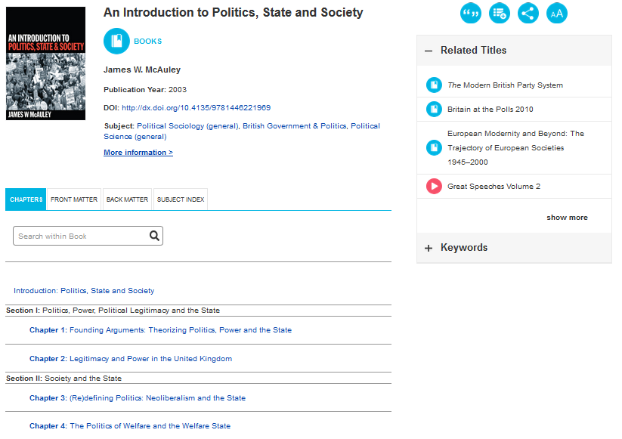
Entire Work page
View more information about the work
View SAGE Knowledge titles similar to the one you are viewing
Switch between different tabs; the main tab you will want to use is the Chapters view
Browse the title’s contents and open specific chapters or entries depending on your needs and interests

Slide 21
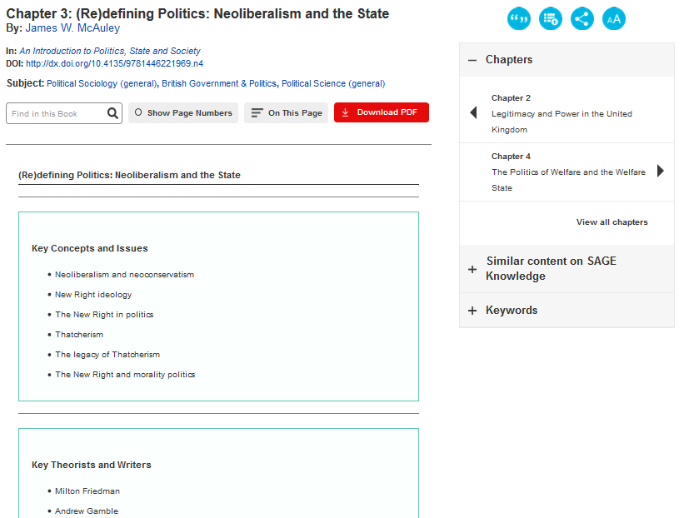
Chapter and Entry page
Download citation information for this item
Search for a term within this chapter or entry
Share item link via email or social media
Browse through other chapters and entries in this work
Download this item as a PDF
(please note, PDF download is not available for Entire Works)
Full text of chapter or entry continues down the page

Slide 22
Creating a Profile
Back to Contents
Saving searches and managing lists

Slide 23
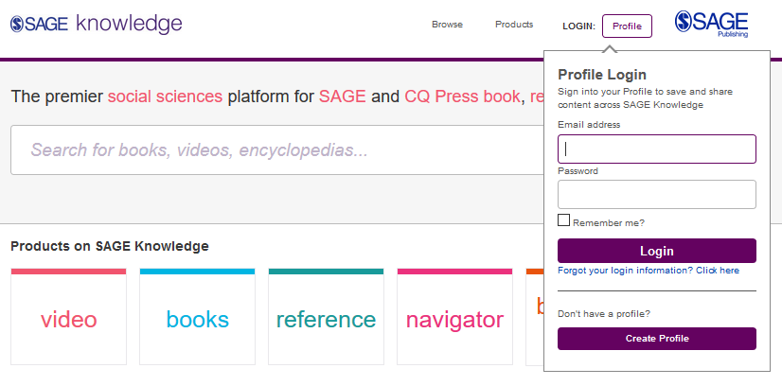
Creating a Profile
Click the Profile button and then click on the button Create Profile; fill in your details in the form that appears.
Once you’ve created your free profile, you can log in here at any time.

Slide 24
Saving searches
When you’re logged into your Profile and you are viewing your search results, click the Save Search icon to save your search criteria, so that you can quickly re-run the same search again later.

Slide 25
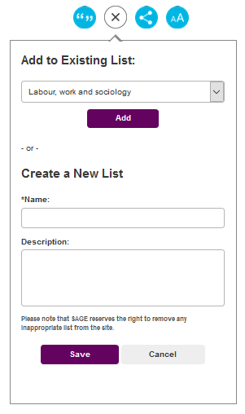
Managing lists
When logged in to your Profile, you can add resources to My Lists in order to save items of interest for later.
On any resource page, click the Add to My Lists icon.
When the pop-up window appears, choose an existing list to add your resource to, or create a new list.

Slide 26
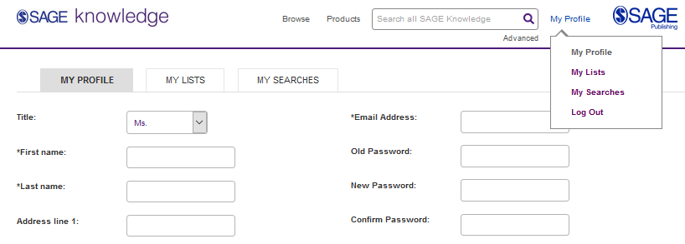
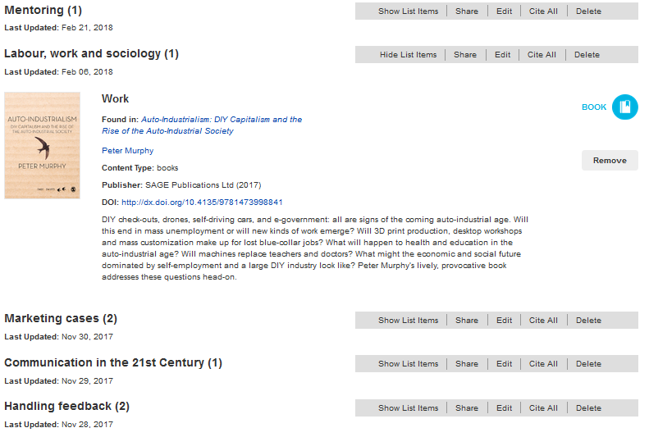
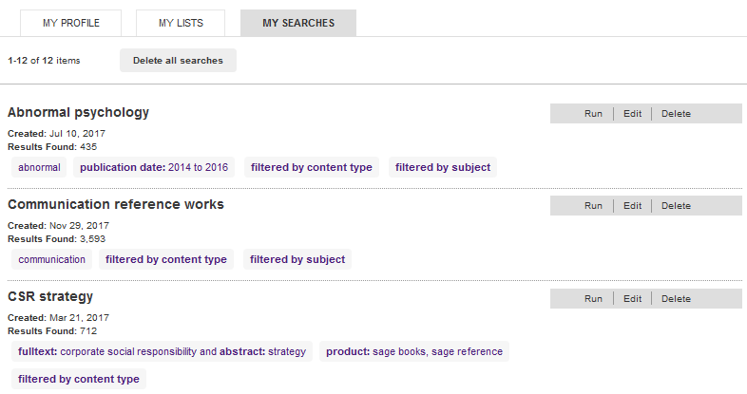
Managing your Profile
You can access your lists and saved searches by clicking on My Profile from any page when you are logged in.
My Lists
My Searches

Slide 27
Do you have any questions?

Slide 28
Thank you for listening!

